Slide 1
Introduction of Structured Learning
Hung-yi Lee

Slide 2
Structured Learning
We need a more powerful function f
Input and output are both objects with structures
Object: sequence, list, tree, bounding box …
X is the space of one kind of object
Y is the space of another kind of object
In the previous lectures, the input and output are both vectors.
Notes:
Can DNN do that?

Slide 3
Example Application
Speech recognition
X: Speech signal (sequence) → Y: text (sequence)
Translation
X: Mandarin sentence (sequence) → Y: English sentence (sequence)
Syntactic Paring
X: sentence → Y: parsing tree (tree structure)
Object Detection
X: Image → Y: bounding box
Summarization
X: long document → Y: summary (short paragraph)
Retrieval
X: keyword → Y: search result (a list of webpage)
Notes:
Translation: http://citeseerx.ist.psu.edu/viewdoc/download?doi=10.1.1.377.8742&rep=rep1&type=pdf

Slide 4
Introduction of Structured Learning
Unified Framework

Slide 5
Unified Framework
Training
Find a function F
Inference (Testing)
Given an object x
F(x,y): evaluate how compatible the objects x and y is
Notes:
F(x,y): evaluate how compatible the objects x and y is
F(x,y)：评估对象 x 和 y 的兼容性

Slide 6
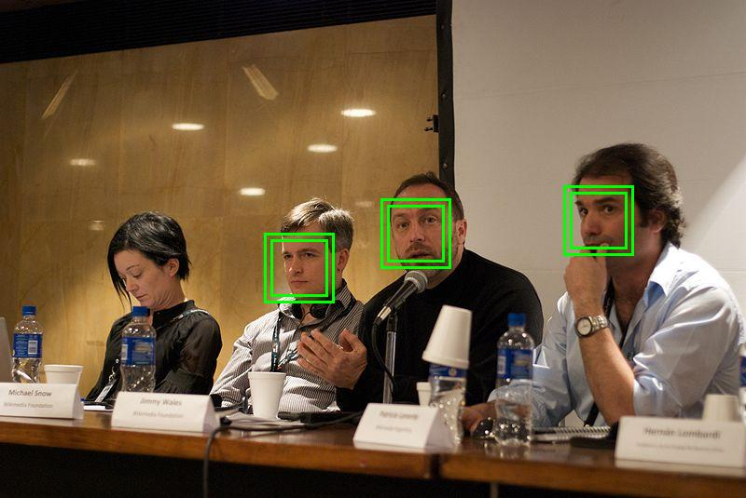
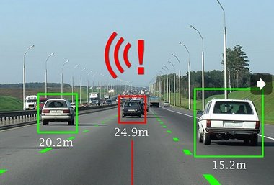

Unified Framework – Object Detection
Task description
Using a bounding box to highlight the position of a certain object in an image
E.g. A detector of Haruhi
Image
Bounding Box
Haruhi
(the girl with yellow ribbon)

Slide 7
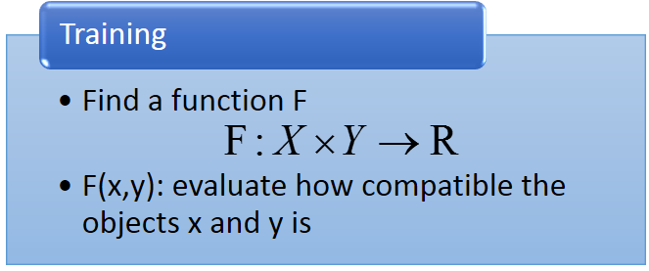



Unified Framework – Object Detection
F(x,y)
x: Image
y: Bounding Box
F(x,y)
F( )
the correctness of taking range of y in x as “Haruhi”

Slide 8

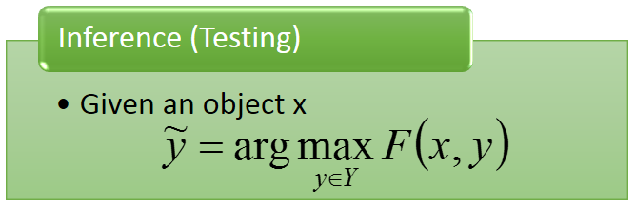


Unified Framework – Object Detection
(output result)
$$\tilde{y}$$
F(x,y)
10
3
2
……
input x =
Enumerate all possible bounding box y
-1

Slide 9



Unified Framework - Summarization
Task description
Given a long document
Select a set of sentences from the document, and cascade the sentences to form a short paragraph
long document
={s₁, s₂, s₃, ……s_{i}…}
summary
={s₁, s₃, s₅}
s_{i}: the i^{th} sentence

Slide 10





Unified Framework - Summarization
Training
Inference
F(x,y)
F(x,y)
x
y
x
y
d’
{s₁, s₃, s₅}
d₁
d₂
d’
{s₂, s₄, s₆}
d₁
d₂
d’
{s₃, s₆, s₉}

Slide 11
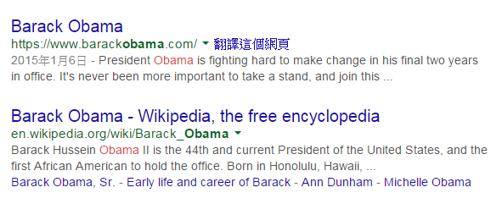
Unified Framework - Retrieval
Task description
User input a keyword Q
System returns a list of web pages
d10011
“Obama”
(keyword)
d98776
……
A list of web pages (Search Result)

Slide 12
Unified Framework - Retrieval
Training
Inference
F(x,y)
F(x,y)
d203
d330
……
d103
d300
……
x=“Haruhi”,
y=
d103
d300
……
x=“Obama”,
y=
x=“Trump”,
y=
d103
d304
……
x=“Haruhi”,
y=
d666
d444
……
x=“Obama”,
y=
d133
d220
……
x=“Trump”,
y=
d103
d305
……
x=“Haruhi”,
y=

Slide 13
Statistics
Training
Estimate the probability P(x,y)
Inference
Given an object x
Unified Framework
Training
Find a function F
Inference
Given an object x
F(x,y): evaluate how compatible the objects x and y is

Slide 14
Statistics
Training
Estimate the probability P(x,y)
Inference
Given an object x
Unified Framework
Drawback for probability
Probability cannot explain everything
0-1 constraint is not necessary
Strength for probability
Meaningful
Energy-based Model: http://www.cs.nyu.edu/~yann/research/ebm/
Notes:
Statistics give unnecessary constraint.
Constraint: output 0 – 1 is difficult
Probability cannot explain everything
x=keyword, y=search results, what is the meaning of P(x,y)?
It is hard to estimate the probability
Can not observe the same object twice

Slide 15
Unified Framework
That’s it!?
Training
Find a function F
Inference (Testing)
Given an object x
F(x,y): evaluate how compatible the objects x and y is
There are three problems in this framework.
Notes:
What is F? different people give it different name, Yan LaCu call it Enerygy model
This framework is every where

Slide 16


Problem 1
Evaluation: What does F(x,y) look like?
How F(x,y) compute the “compatibility” of objects x and y
Object Detection:
F(x= , y= )
Summarization:
F(x= , y= )
(a long document)
(a short paragraph)
Retrieval:
F(x= “Obama” , y= )
(keyword)
(Search Result)

Slide 17
Problem 2
Inference: How to solve the “arg max” problem
The space Y can be extremely large!
Object Detection:
Y=All possible bounding box
(maybe tractable)
Summarization:
Y=All combination of sentence set in a document …
Retrieval:
Y=All possible webpage ranking ….

Slide 18
Problem 3
Training: Given training data, how to find F(x,y)
Principle
Training data:
We should find F(x,y) such that ……
……
……
for all
for all
for all

Slide 19



Three Problems
Problem 1: Evaluation
Problem 2: Inference
Problem 3: Training
What does F(x,y) look like?
Given training data, how to find F(x,y)
How to solve the “arg max” problem
Notes:
Have you ever heard this three questions before
No general task dependent
Ring a bell!!!!!!!!!!

Slide 20
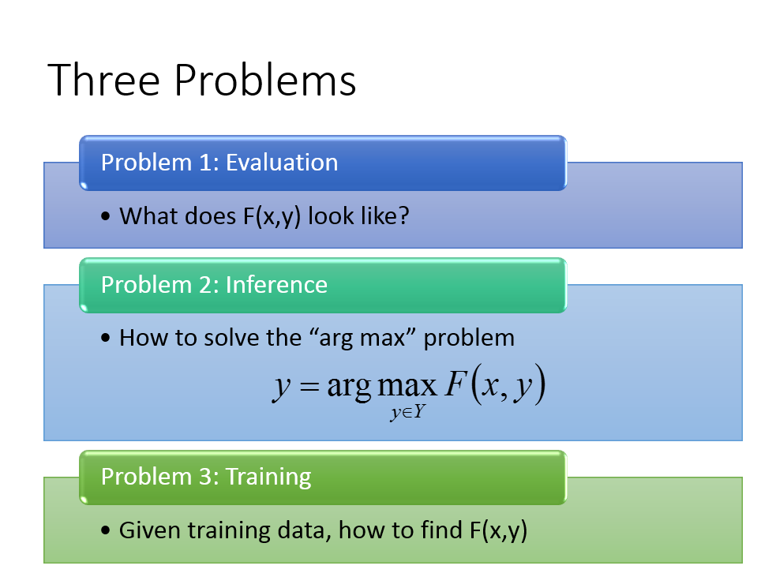
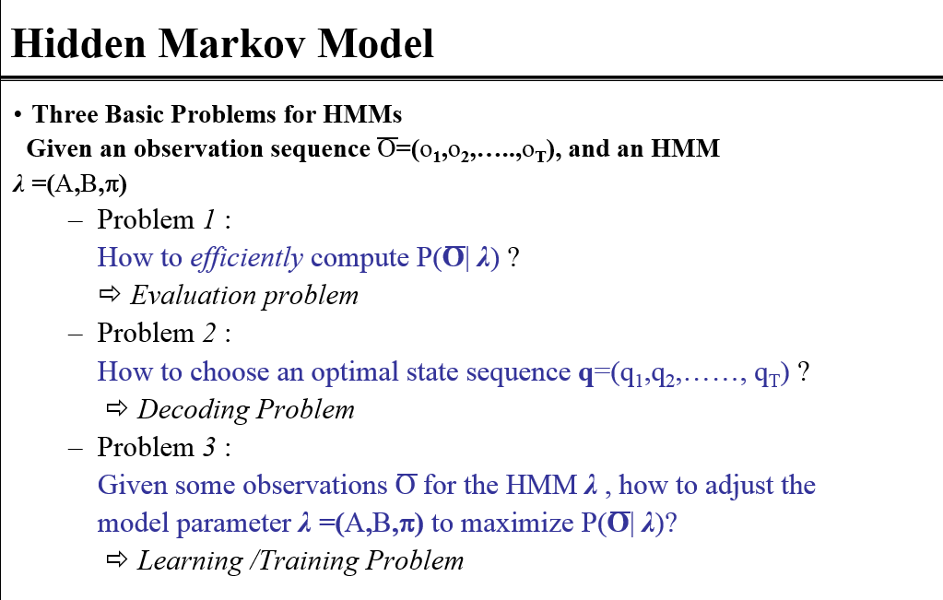
Have you heard the three problems elsewhere?
From 數位語音處理

Slide 21


Link to DNN?
The same as what we have learned.
Training
Inference
In handwriting digit classification, there are only 10 possible y.
y = [ 1 0 0 0 …… ]
N(x)
y = [ 0 1 0 0 …… ]
y = [ 0 0 1 0 …… ]
DNN
…
Find max
$$x$$
F(x,y)
$$x$$
Notes:
Can you answer the three problems for DNN?

Slide 22
Introduction of Structured Learning
Linear Model

Slide 23
Structured Linear Model
Problem 1: Evaluation
Problem 2: Inference
Problem 3: Training
What does F(x,y) look like?
Given training data, how to find F(x,y)
How to solve the “arg max” problem
in a specific form
Notes:
Which one is the easiest?
Strucutred Linear model delete the hardest one

Slide 24
Structured Linear Model: Problem 1
Evaluation: What does F(x,y) look like?
Characteristics
x
y
Learning from data
Notes:
Characteristics
weights

Slide 25


Structured Linear Model: Problem 1
Evaluation: What does F(x,y) look like?
Example: Object Detection
percentage of color red in box y
$$x$$
$$y$$
percentage of color green in box y
percentage of color blue in box y
percentage of color red out of box y
$$φ\left( \right)$$
=
……
area of box y
number of specific patterns in box y
……
Notes:
Phi can be the output of very complex model, detector

Slide 26
Convolutional
Layer
Sub-sampling
Layer
Fully-connected
Layer
Output
Layer
$$φ\left( \right)$$
Notes:
1000-dim vector
before softmax

Slide 27
Structured Linear Model: Problem 2
Inference: How to solve the “arg max” problem
Assume we have solved this question.

Slide 28
Structured Linear Model: Problem 3
Training: Given training data, how to learn F(x,y)
F(x,y) = w·φ(x,y), so what we have to learn is w
Training data:
We should find w such that
(All training examples)
(All incorrect label for r-th example)
Notes:
If we can solve question 2, then we can solve question 3

Slide 29


Structured Linear Model: Problem 3
$${\hat{y}}^{1}$$
$$x^{1}$$
$${\hat{y}}^{2}$$
$$φ\left( \right)$$
$$x^{2}$$
$$φ\left( \right)$$
$$φ\left( \right)$$

Slide 30
Structured Linear Model: Problem 3
$$φ\left( \right)$$
$${\hat{y}}^{1}$$
$$x^{1}$$
$${\hat{y}}^{2}$$
$$φ\left( \right)$$
$$x^{2}$$
$$φ\left( \right)$$

Slide 31
Structured Linear Model: Problem 3
$${\hat{y}}^{1}$$
$$x^{1}$$
$${\hat{y}}^{2}$$
$$x^{2}$$

Slide 32
Solution of Problem 3
Difficult?
Not as difficult as expected
Notes:
Structured Perceptron Learning Algorithm

Slide 33
Algorithm
Will it terminate?
Input: training data set
Output: weight vector w
Algorithm: Initialize w = 0
do
For each pair of training example
Find the label ${\tilde{y}}^{r}$ maximizing $w∙φ\left(x^{r},y\right)$
If , update w
until w is not updated
(question 2)
We are done!
Notes:
Question 1 and 2 is solved.
Important: if the weight if not update, end the algorithm

Slide 34
Algorithm - Example
$${\hat{y}}^{1}$$
$$x^{1}$$
$${\hat{y}}^{2}$$
$$x^{2}$$

Slide 35
Algorithm - Example
Initialize w = 0
pick
If , update w
Because w=0 at this time, $φ\left(x^{1},y\right)$ always 0
Random pick one point as ${\tilde{y}}^{r}$

Slide 36
Algorithm - Example
pick
If , update w

Slide 37
Algorithm - Example
pick again
do not update w
pick again
do not update w
So we are done

Slide 38
Assumption: Separable
There exists a weight vector $\hat{w}$
(All training examples)
(All incorrect label for an example)
(The target exists)
Notes:
If we can then we are done
Can structured perceptron algorithm achieve that?
Can structured perceptron find the weight w having the same direction as w*?
If there is not w*, may be you should redesign your ph

Slide 39
Assumption: Separable

Slide 40
Proof of Termination
w is updated once it sees a mistake
(the relation of w^{k} and w^{k-1})
Proof that:
The angle ρ_{k} between and w_{k} is smaller as k increases
Analysis
(larger and larger?)
(Separable)
Notes:
It is not update every time (some of them is not updated when seeing the enough examples)

Slide 41
Proof of Termination
w is updated once it sees a mistake
(the relation of w^{k} and w^{k-1})
Proof that:
The angle ρ_{k} between and w_{k} is smaller as k increases
Analysis
(larger and larger?)
=0
≥δ
(so what)
Notes:
It is not update every time (some of them is not updated when seeing the enough examples)

Slide 42
Proof of Termination
?
(mistake)
Assume the distance between any two feature vector is smaller than R
Notes:
X = a + b
||x||2 = (a+b)T(a+b) = (aT + bT) (a + b)
= aTa + bTb + 2 a dot b

Slide 43
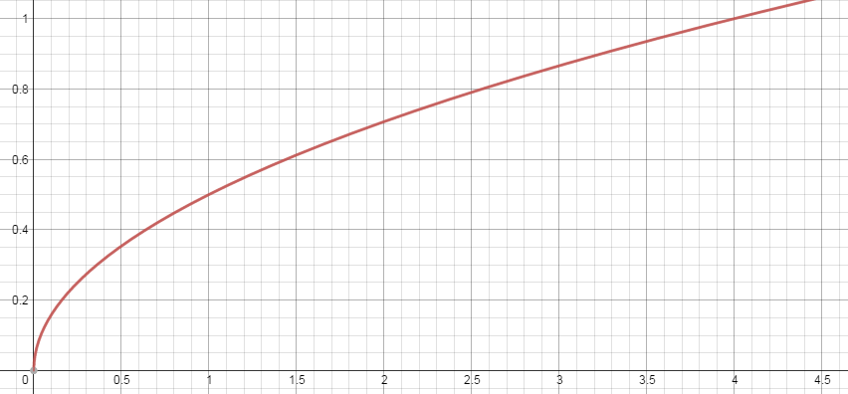
Proof of Termination

Slide 44
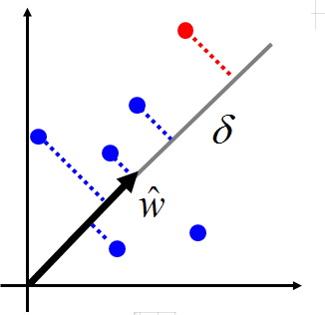
Proof of Termination
The largest distances between features
Normalization
Margin: Is it easy to separable red points from the blue ones
Larger margin, less update
All feature times 2

Slide 45
Structured Linear Model: Reduce 3 Problems to 2
Problem 1: Evaluation
How to define F(x,y)
Problem 2: Inference
How to find the y with the largest F(x,y)
Problem 3: Training
How to learn F(x,y)
F(x,y)=w·φ(x,y)
Problem A: Feature
How to define φ(x,y)
Problem B: Inference
How to find the y with the largest w·φ(x,y)

Slide 46
Graphical Model
A language which describes the evaluation function
Notes:
MRF <> Hammersley–Clifford theorem
Graphical model
Provide an intuitive way to define $F\left(x,y\right)$
Make the meaning of a defined $F\left(x,y\right)$ easy to be interpreted
For structured learning like structured perceptron, know how to inference solve the problem
Inference for everyone when using MRF
Outline:
1. decomposed
2. factor
3. factor to MRF
4. how to train it

Slide 47
Structured Learning
We also know how to involve hidden information.
Problem 1: Evaluation
Problem 2: Inference
Problem 3: Training
What does F(x,y) look like?
Given training data, how to find F(x,y)
How to solve the “arg max” problem
$$F\left(x,y\right)=w∙φ\left(x,y\right)$$
Structured SVM, etc.
Notes:
can not use it casually?

Slide 48
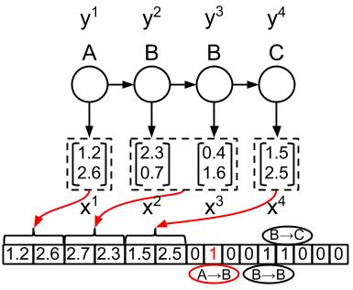
Difficulties
Difficulty 1. Evaluation
Graphical Model
$F\left(x,y\right)=w∙φ\left(x,y\right)$
$φ\left(x,y\right)$
Hard to figure out? Hard to interpret the meaning?
Difficulty 2. Inference
Gibbs Sampling
We can use Viterbi algorithm to deal with sequence labeling. How about other cases?

Slide 49
Graphical Model
Define and describe your evaluation function F(x,y) by a graph
There are three kinds of graphical model.
Factor graph, Markov Random Field (MRF) and Bayesian Network (BN)
Only factor graph and MRF will be briefly mentioned today.
$$F\left(x,y\right)$$
Graph
Notes:
Define easily and Understand others’ evaluation function F(x,y) easily

Slide 50
Decompose F(x,y)
$F\left(x,y\right)$ is originally a global function
Define over the whole x and y
Based on graphical model, $F\left(x,y\right)$ is the composition of some local functions
x and y are decomposed into smaller components
Each local function defines on only a few related components in x and y
Which components are related → defined by Graphical model
Notes:
represent a factor

Slide 51
Decomposable x and y
x and y are decomposed into smaller components
POS Tagging
{word}
x₁
x₂
x₃
x₄
x:
John saw the saw.
x:
x₁
x₂
x₃
x₄
y₁
y₂
y₃
y₄
y₁
y₂
y₃
y₄
y:
PN V D N
y:
{tags}
Notes:
樣本空間

Slide 52
Factor Graph
Each factor influences some components.
Each factor corresponds to a local function.
X
Y
x₁
x₂
y₁
y₂
factor a
factor b
factor c
$$f_{a}\left(x_{1},y_{1}\right)$$
$$f_{b}\left(x_{2},y_{1},y_{2}\right)$$
$$f_{d}\left(y_{2}\right)$$
Larger value means more compatible.
$$F\left(x,y\right)=f_{a}\left(x_{1},y_{1}\right)+f_{b}\left(x_{2},y_{1},y_{2}\right)+f_{c}\left(y_{2}\right)$$
You only have to define the factors.
The local functions of the factors are learned from data.
Notes:
This is factor graph.
Factor defined first

Slide 53


Factor Graph - Example
Image De-noising
Each pixel is one component
…
…
…
Noisy image x
{-1,1}
x₇
x₈
x₉
……
x₄
x₅
x₆
……
x₁
x₂
x₃
……
…
…
…
Clean image y
{-1,1}
y₇
y₈
y₉
……
y₄
y₅
y₆
……
y₁
y₂
y₃
……
http://cs.stanford.edu/people/karpathy/visml/ising_example.html
Notes:
If you think democe is not cool, …..
http://www.mathworks.com/help/images/ref/imnoise.html

Slide 54
Factor Graph - Example
Noisy and clean images are related
a: the values of x_{i} and y_{i}
Factor:
The colors in the clean image is smooth.
b: the values of the neighboring y_{i}
x₃
x₄
$$f_{a}\left(x_{i},y_{i}\right)=\left\{\begin{matrix}1 & x_{i}=y_{i} \\ −1 & x_{i}≠y_{i}\end{matrix}\right.$$
noisy image
x₁
x₂
a
a
$$f_{b}\left(y_{i},y_{j}\right)=\left\{\begin{matrix}2 & y_{i}=y_{j} \\ −2 & y_{i}≠y_{j}\end{matrix}\right.$$
a
a
y₃
y₄
b
cleaned image
y₁
b
y₂
The weights can be learned from data.
b
b
Notes:
It is still bipartite
How about x
Should it be zero-one

Slide 55
Factor Graph - Example
Noisy and clean images are related
a: the values of x_{i} and y_{i}
Factor:
The colors in the clean image is smooth.
b: the values of the neighboring y_{i}
x₃
x₄
Realize $F\left(x,y\right)$ easily from the factor graph
noisy image
x₁
x₂
a
a
$$\sum_{i=1}^{4}{f_{a}\left(x_{i},y_{i}\right)}$$
$F\left(x,y\right)$=
a
a
y₃
y₄
b
$$+f_{b}\left(x_{1},y_{2}\right)+f_{b}\left(x_{1},y_{3}\right)$$
$$+f_{b}\left(x_{2},y_{4}\right)+f_{b}\left(x_{3},y_{4}\right)$$
cleaned image
y₁
b
y₂
b
b
Notes:
It is still bipartite
How about x
Should it be zero-one

Slide 56
Factor Graph - Example
Factor:
c: the values of x_{i} and the values of the neighboring y_{i}
d: the values of the neighboring x_{i} and the values of y_{i}
x_{i-1}
x_{i}
d
$$f_{c}\left(x_{i},y_{i},y_{i−1}\right)$$
d
e
e
$$f_{d}\left(x_{i},x_{i−1},y_{i}\right)$$
c
……
c
……
y_{i-1}
y_{i}
$$f_{e}\left(x_{i},x_{i−1},y_{i},y_{i−1}\right)$$
……
……
……
……
Notes:
How about x
Should it be zero-one

Slide 57
Markov Random Field (MRF)
Clique: a set of components connecting to each other
Maximum Clique: a clique that is not included by other cliques
B
D
A
C

Slide 58
MRF
Each maximum clique on the graph corresponds to a factor
MRF
Factor Graph
A
B
A
B
$$f\left(A,B\right)$$
B
A
B
C
A
C
$$f\left(A,B,C\right)$$
B
D
A
B
C
D
A
C
$$f\left(A,B,C,D\right)$$
Notes:
What if we have duplicate …..

Slide 59
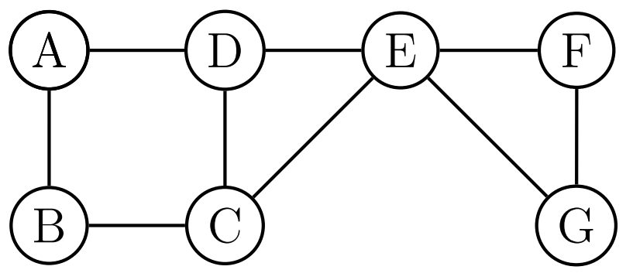
MRF
MRF
Factor Graph
b
a
d
e
c
Evaluation Function
$$f_{a}\left(A,B\right){+f}_{b}\left(A,D\right)+f_{c}\left(B,C\right)+f_{d}\left(C,D,E\right)+f_{e}\left(E,F,G\right)$$

Slide 60
Training
x₁
x₂
a
y₂
b
y₁
$$F\left(x,y\right)=f_{a}\left(x_{1},x_{2},y_{1}\right)+f_{b}\left(y_{1},y_{2}\right)$$
$$=w_{a}∙φ_{a}\left(x_{1},x_{2},y_{1}\right)$$
$$+w_{b}∙φ_{b}\left(y_{1},y_{2}\right)$$
$$=\left[\begin{aligned}w_{a} \\ w_{b}\end{aligned}\right]\left[\begin{aligned}φ_{a}\left(x_{1},x_{2},y_{1}\right) \\ φ_{b}\left(y_{1},y_{2}\right)\end{aligned}\right]$$
Simply training by structured perceptron or structured SVM
$$=w∙φ\left(x,y\right)$$
Max-Margin Markov Networks (M3N)

Slide 61
Training
x₁
x₂
$$φ_{b}\left(+1,+1\right)=\left[\begin{aligned}1 \\ 0 \\ 0 \\ 0\end{aligned}\right]$$
a
y₂
b
y₁
$$φ_{b}\left(+1,−1\right)=\left[\begin{aligned}0 \\ 1 \\ 0 \\ 0\end{aligned}\right]$$
$$F\left(x,y\right)=f_{a}\left(x_{1},x_{2},y_{1}\right)+f_{b}\left(y_{1},y_{2}\right)$$
$$=w_{a}∙φ_{a}\left(x_{1},x_{2},y_{1}\right)$$
$$+w_{b}∙φ_{b}\left(y_{1},y_{2}\right)$$
$$φ_{b}\left(−1,+1\right)=\left[\begin{aligned}0 \\ 0 \\ 1 \\ 0\end{aligned}\right]$$
$$y_{1},y_{2}ε\left\{+1,−1\right\}$$
y₁ | y₂ | $$f_{b}\left(y_{1},y_{2}\right)$$
+1 | +1 | w₁
+1 | -1 | w₂
-1 | +1 | w₃
-1 | -1 | w₄
$$w_{b}=\left[\begin{aligned}w_{1} \\ w_{2} \\ w_{3} \\ w_{4}\end{aligned}\right]$$
$$φ_{b}\left(−1,−1\right)=\left[\begin{aligned}0 \\ 0 \\ 0 \\ 1\end{aligned}\right]$$

Slide 62
Now can you interpret this?
$φ\left(x,y\right)$

Slide 63
Probability Point of View
$F\left(x,y\right)$ can be any real number
If you like probability
Between 0 and 1
To be positive
$$P\left(x,y\right)=\frac{e^{F\left(x,y\right)}}{\sum_{x^{′},y^{′}}{e^{F\left(x^{′},y^{′}\right)}}}$$
normalization
$$=\frac{P\left(x,y\right)}{P\left(x\right)}$$
$$P\left(y|x\right)$$
$$=\frac{\frac{e^{F\left(x,y\right)}}{\sum_{x^{′},y^{′}}{e^{F\left(x^{′},y^{′}\right)}}}}{\sum_{y^{′′}}{\frac{e^{F\left(x,y^{′′}\right)}}{\sum_{x^{′},y^{′}}{e^{F\left(x^{′},y^{′}\right)}}}}}$$
$$=\frac{P\left(x,y\right)}{\sum_{y^{′′}}{P\left(x,y^{′′}\right)}}$$
$$=\frac{e^{F\left(x,y\right)}}{\sum_{y^{′′}}{e^{F\left(x,y^{′′}\right)}}}$$
Notes:
Maybe I have to mention some more examples in the next pages

Slide 64
Evaluation Function
We want to find an evaluation function F(x)
Input: object x, output: scalar F(x) (how “good” the object is)
E.g. x are images
Real x has high F(x)
F(x) can be a network
We can generate good x by F(x):
Find x with large F(x)
How to find F(x)?
object
x
Evaluation Function F
scalar
F(x)
F(x)
In practice, you cannot decrease all the x other than real data.
real data

Slide 65
Evaluation Function - Structured Perceptron
Input: training data set
Output: weight vector w
Algorithm: Initialize w = 0
do
For each pair of training example
Find the label ${\tilde{y}}^{r}$ maximizing F$\left(x^{r},y\right)$
If , update w
until w is not updated
Can be an issue
Increase $F\left(x^{r},{\hat{y}}^{r}\right)$, decrease $F\left(x^{r},{\tilde{y}}^{r} \right)$
We are done!
Notes:
contrastive
Question 1 and 2 is solved.
Important: if the weight if not update, end the algorithm

Slide 66
How about GAN?
$$F\left(x\right)$$
Generator is an intelligent way to find the negative examples.
“Experience replay”, parameters from last iteration
$$F\left(x\right)$$
In the end ……
$$F\left(x\right)$$
$$F\left(x\right)$$

Slide 67
Where are we?
Restricted Boltzmann Machine
Boltzmann Machine
Undirected Graph
(MRF, factor graph, etc.)
Graphical Model
Structured Learning

